Slide 1
Building Data Pipeline For Over-The-Top(OTT) Platforms
Presented By:
Mayur Mane
Kanak Kaletha
Swaroop Dhage
Shubham
Raj
Asmita
Ankita Singh
Aman
Suyash
Himanshu

Slide 2
Technology Used:
S3 Bucket
Git Action
Trigger
Lambda
Cloud Formation Template(CFT)
Glue Crawler
Amazon Athena
AWS Glue
AWS Cloudwatch
Power Bi

Slide 3
Step Of Flow Diagram
Data Extraction
Storing Data in S3
Triggering Lambda Function from GitHub Action
Two Methods Used
CloudFormation Template
AWS Glue
Clean Data in S3
Glue Crawler
Athena
Power BI

Slide 4
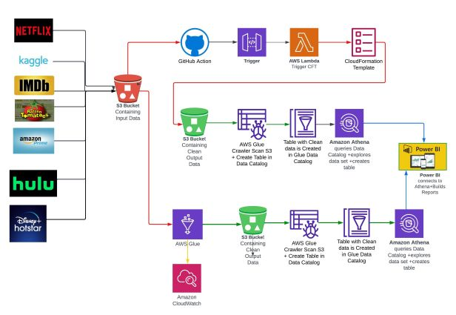
Flow Diagram

Slide 5
Two Content Layout with SmartArt

